Slide 1
Angular Component Trees
Peter Eijgermans peter.eijgermans@ordina.nl

Slide 2
Angular-app = Tree of components
<todo-app>
<todos-list>
<todo-item>
<todo-item>
{{ todo-text}}
{{ todo-text}}
{{ todo-checked}}
{{ todo-checked}}

Slide 3
Angular-app = Tree of components
Steps to create Multiple child components?
Create a separate Child Component
Define this component in the app.module.ts
Add this component in the HTML of the parent-component
Repeat these steps for all other child components

Slide 4
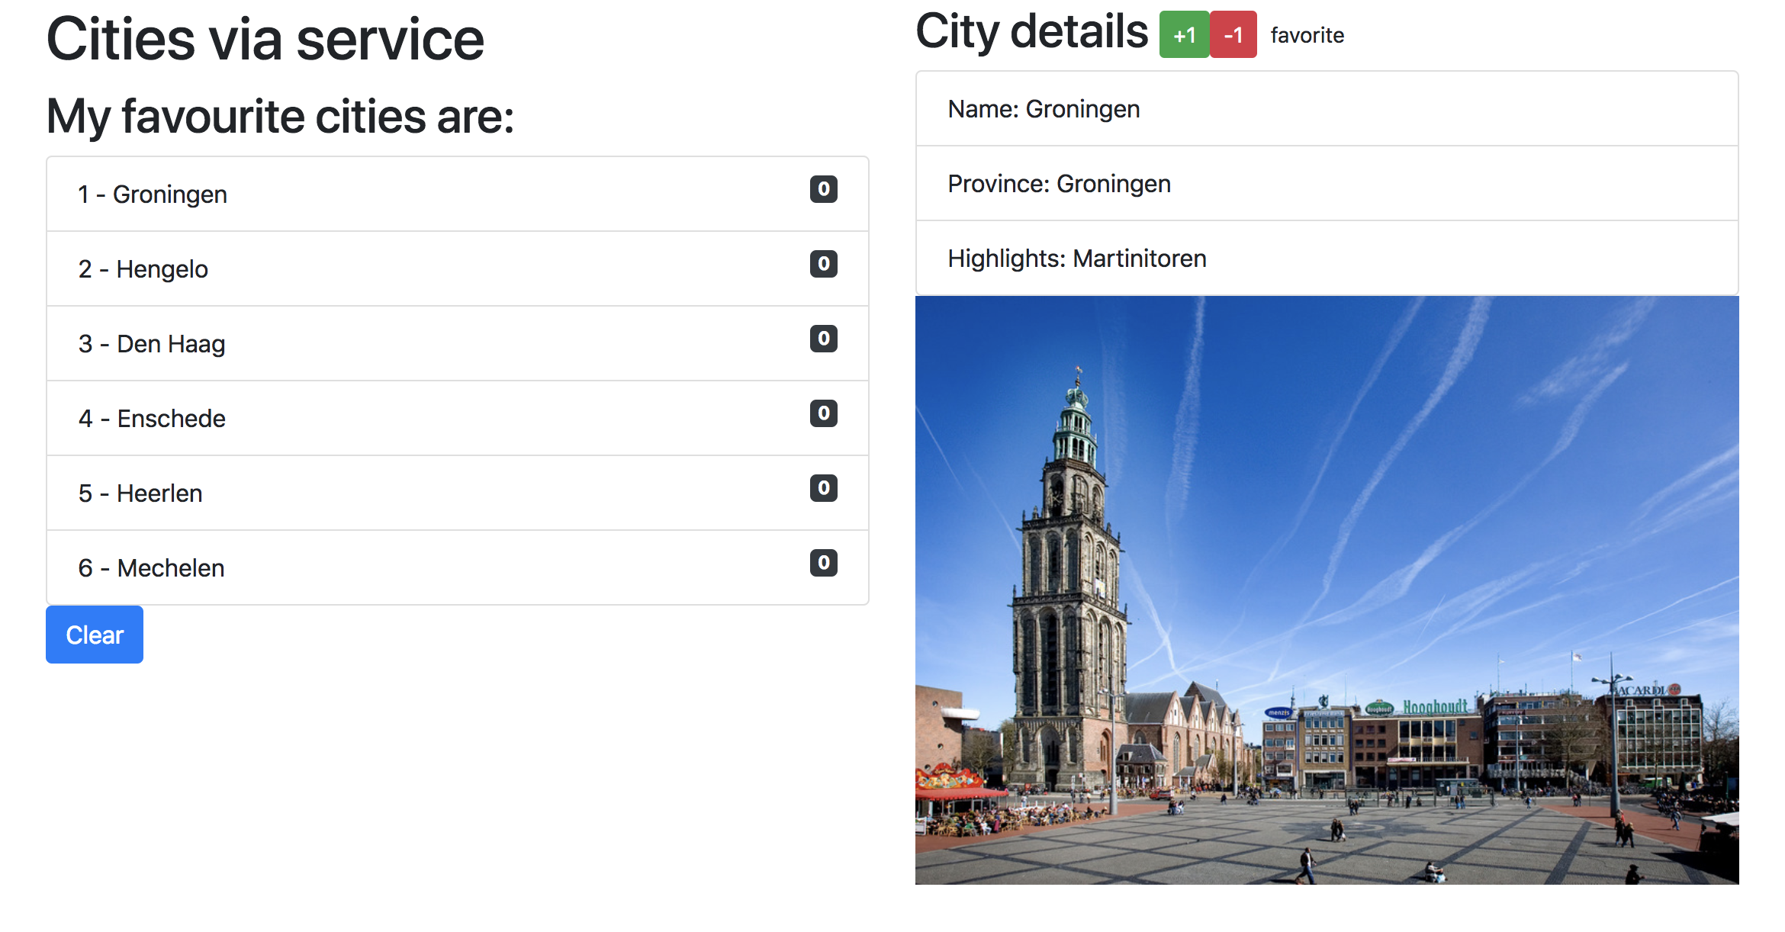

Slide 5
Component based
SideBarComponent
AppModule
AppComponent
CityListComponent
CityDetailComponent
Notes:
Angular apps are composed of modules.
Modules exports classes, function, values — that other modules import.

Slide 6
Component based A component adds logic to DOM elements Angular app consist of a treestructuur of components
main.ts
AppModule
AppComponent
app.component.html
CityListComponent
CityDetailComponent
city-detail.component.html
Notes:
Angular is a tree of components, because it has the same structure as your html-structure !!!
Index.html is the parent template of AppComponent ect…
AppComponent is the parent of BookComponent and …
main.ts

Slide 7
1. Create a separate City-detail component
import { Component } from '@angular/core';
@Component({
selector: 'city‐detail',
template: `
<h2>City details</h2>
<ul class="list‐group">
<li class="list‐group‐item">Naam: [naam van stad]</li>
<li class="list‐group‐item">Provincie: [provincie]</li>
<li class="list‐group‐item">Highlights: [highlights]</li>
</ul>
`
})
export class CityDetailComponent {}
Nieuwe selector
Nog in te vullen

Slide 8
2. Define this component in the app.module.ts
// app.module.ts
…
import {CityDetailComponent} from './city.detail'; // Nieuwe component invoegen
@ngModule({
…
declarations:[…,CityDetailComponent]
})
// invoegen bij declarations!
export class AppModule {
…
}

Slide 9
3. Add this component in the HTML of the parent-component
<!‐‐ app.html ‐‐>
<div class="row">
<div class="col‐md‐6">
…
<city‐detail></city‐detail>
</div>
</div>
Combineren met overige HTML

Slide 10
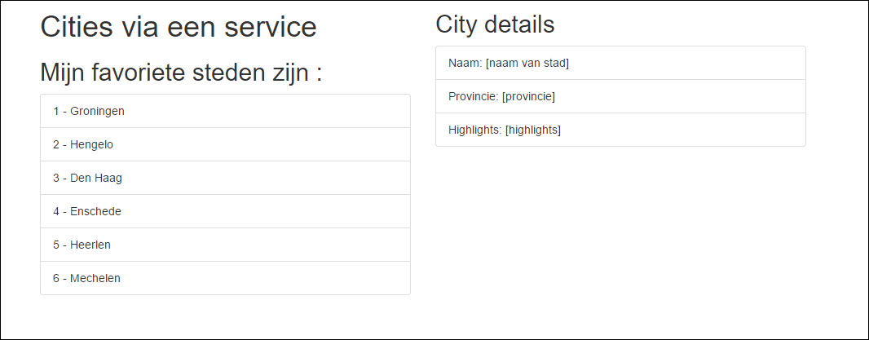
4. Result
To Do

Slide 11
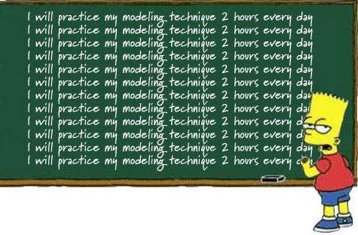
Checkpoint
See: 6a + 6b
Oefening….

Slide 12
Data flow between components
Use inputs and outputs

Slide 13
Data flow between components
“Data flows to a component via
@Input() ‘s”
Data flows out of a component via
@Output()’s”

Slide 14
@Input

Slide 15
Parent-Child flow: use annotation @Input()
<city-app>
[city]=“currentCity”
…
@Input() city: City
<city-detail>
{{ city.name}}
{{ city.province}}

Slide 16
Use @Input() in ChildComponent
Import the Input service in the component
Use the Annotation @Input() in the class definition
// city.detail.ts
import { Component, Input } from '@angular/core'; import { City } from "./city.model";
@Component({
…
})
export class CityDetailComponent {
@Input() public city: City;
}
Input

Slide 17
Change the Parent HTML for @Input
<!‐‐ app.html ‐‐>
<div class="row">
<div class="col‐md‐6">
…
<ul class="list‐group">
<li *ngFor="let city of cities" class="list‐group‐item" (click)="getCity(city)">
{{ city.id}} ‐ {{ city.name }}
</li>
</ul>
</div>
<div *ngIf="currentCity">
<city‐detail [city]="currentCity"></city‐detail>
</div>
</div>
</div>
Aanpassing
Change!

Slide 18
Change the Parent Component Class
export class AppComponent {
// Properties voor de component/class
private cities: City[];
private currentCity: City;
public getCity(city): void {
this.currentCity = city;
}
…
}

Slide 19
1. Create a separate City-detail component
@Component({ selector: 'city-detail', template: ` <h2>City details</h2> <div *ngIf="city"> <ul class="list-group"> <li class="list-group-item">Name: {{ city.name }}</li> <li class="list-group-item">Province: {{city.province}}</li> <li class="list-group-item">Highlights: {{city.highlights}}</li> </ul> <img src="../assets/img/{{ city.name }}.jpg"
alt="Photo of {{ city.name }}" class="img-fluid"/> </div> ` }) export class CityDetailComponent { @Input() public city: City; }
Nieuwe selector
Nog in te vullen

Slide 20
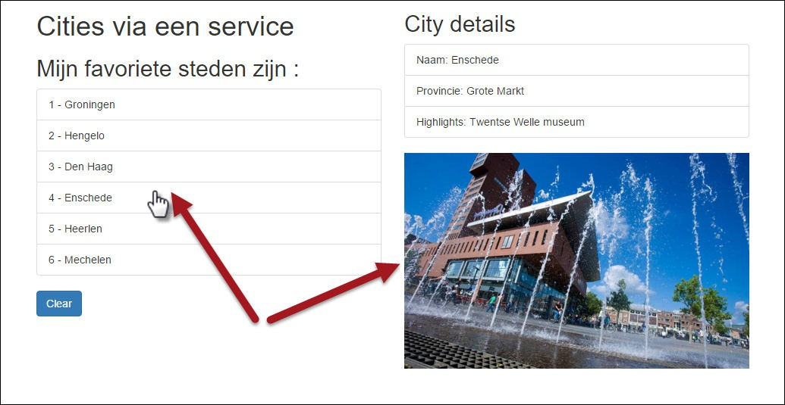
Result

Slide 21
Checkpoint
Data flow to Child Component : Use @Input() and
[propName]=“data”
See: 6c
Exercise….

Slide 22
@Output

Slide 23
Child-Parent flow: use annotation @Output()
<city-app>
(event)=“myEvent($event)”
…
@Output() event: EventEmitter<Type>
<city-detail>
{{ city.name}}
{{ city.province}}
P.165

Slide 25
Steps to take
Import Service Output in the CityDetailcomponent
Use annotation @Output() in de class definition
3. Define EventEmitter and the Type Annotation
“With @Output,
data flows up the Component Chain”
18

Slide 26
Give rating to Cities
// city.detail.ts
import { Component, EventEmitter, Input, Output } from '@angular/core'; @Component({
selector: 'city‐detail', template: ` <h2>City details <button (click)="rate(1)">+1</button> <button (click)="rate(-1)">‐1</button> </h2> ` }) export class CityDetailComponent { @Input() public city: City; @Output() public rating: EventEmitter<number> = new EventEmitter<number>(); public rate(num): void { console.log('rating voor ', this.city.name, ': ', num); this.rating.emit(num); } }
Imports
Bind custom events to DOM
custom
@Output event

Slide 27
Prepare Parent Component to receive custom event
<!‐‐ app.html ‐‐>
<div *ngIf="currentCity">
<city‐detail [city]="currentCity" (rating)="updateRating($event)">
</city‐detail>
</div>
// app.component.ts
// increase or decrease rating on Event Emitted
public updateRating(rating): void{
this.currentCity.rating += rating;
}

Slide 28
Show Rating in the HTML of the Parent
<li *ngFor="let city of cities" class="list‐group‐item" (click)="getCity(city)">
{{ city.id}} ‐ {{ city.name }}
<span class="badge">{{city.rating}}</span>
</li>
Rating

Slide 29
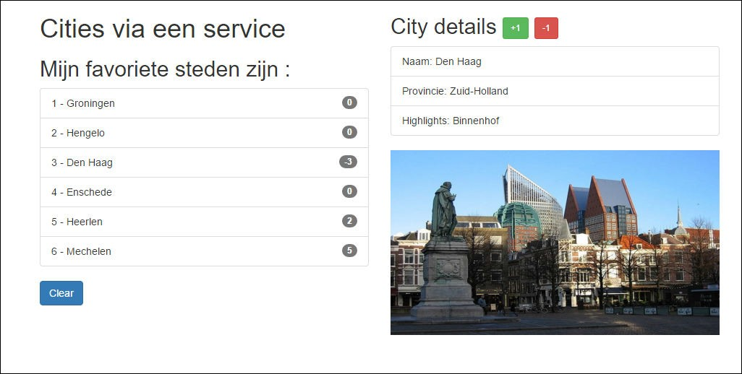
Result

Slide 30
Summary
Parent → Child
Child → Parent
<app>
<app>
[city]=“someCity”
(rate)=“onRate()”
<city-list>
<city-list>
[city]=“someCity”
(rate)=“onRate()”
<city-detail>
<city-detail>

Slide 31
Checkpoint
Data flow to Parent Component : use @Output() and
(eventName)=“eventHandler($event)”
See 6d
Exercise….

Slide 32
Communication between siblings
Parent
<child-
1>
<child-2>
<child-3>

Slide 33
Use Pub/Sub-systeem with Observables
“Custom events, use an event bus”

Slide 34
Subject = Eventbus = queue/topic
Event
App
<component-1>
<component-4>
<component-2>
<component-3>
<component-5>
{{…}
}
{{…}
}
{{…}
}

Slide 35
Use Subject
Notes:
A Subject is a special type of Observable that observers can also subscribe to it to receive published values but with one difference: The values are multicasted to many Observers.
Subjects are also Observers i.e they can also subscribe to other Observables and listen to published data.
By default an RxJS Observable is unicast.
Unicast simply means that each subscribed observer has an independent execution of the Observable while multicast means that the Observable execution is shared by multiple Observers.

Slide 36
Use Subject
Subject() = Observable and Observer
“Publish en Subscribe” – PubSub systeem

Slide 37
<city-list>
<city-details>
Book now!
publish
Event
<city-orders>
subscribe

Slide 38
PubSub-service maken
Step 1 – Make a Publication service
Step 2 – Create ‘Producer’ or ‘Publish’ – component
Step 3 – Create Subscriber-component

Slide 39
1. OrderService
// order.service.ts
import {Subject} from 'rxjs/Subject’;
import {Injectable} from '@angular/core’;
import {City} from '../model/city.model';
@Injectable()
export class OrderService {
public stream: Subject<City>;
constructor() {
this.stream = new Subject<City>();
}
}

Slide 40
2. Producer component (‘book now’- button)
In the HTML:
<h2>Prijs voor een weekendje weg:
{{ city.price | currency:'EUR':true:'1.2' }}
<button class="btn btn‐lg btn‐info" (click)="order(city)">Book now!</button>
</h2>
Class:
// Order plaatsen. Event emitten voor deze stad.
// Dit gaan opvangen in city.orders.ts
export class CityDetailComponent {
public order(city): void {
console.log(`Stedentripje geboekt voor: ${this.city.name}); this.orderService.stream.next(city);
}
}

Slide 41
3. Subscriber component
//city.orders.ts ‐ Een soort 'winkelmandje',
// bijhouden welke stedentripjes zijn geboekt.
import …
@Component({
selector: 'city‐orders', template: `
<div *ngIf="currentOrders.length > 0">
…
})
export class CityOrdersComponent {
public ngOnInit(): void {
this.orderService.stream
.subscribe(
(city:City) => this.processOrder(city), (err)=>console.log('Error bij verwerken City‐order'), ()=>console.log('Complete...')
)
}
` …
}

Slide 42
Share data between sibling components using EventEmitter
https://medium.com/@pandukamuditha/angular-5-share-data-between-sibling-components-using-eventemitter-8ebb49b64a0a

Slide 43
Change Detection

Slide 44
What is Change Detection in Angular?
Change detection means:
Updating the DOM tree whenever data is changed !

Slide 45
When is Change detection executed?
Change detection in Angular is executed when:
There are updates to Angular State variable
Events are invoked inside Angular Component
@Input Values are updated for the Components

Slide 46
Change Detection Strategies?
Change Detection Strategies in Angular:
1. Default Strategy
2. onPush Strategy

Slide 47
When Default Change detection?
For any change in any model property, Angular will run change detection traversing the component tree to update the DOM.

Slide 48
When Onpush Change detection?
Using the OnPush strategy, the change detector is only triggered if a new reference is passed as @Input() value to the ChildComponent(s)

Slide 49
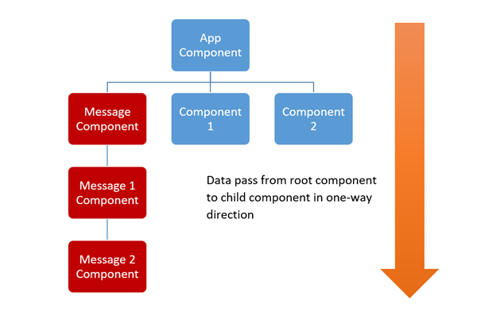

Slide 50
Example Default Change detection

Slide 51
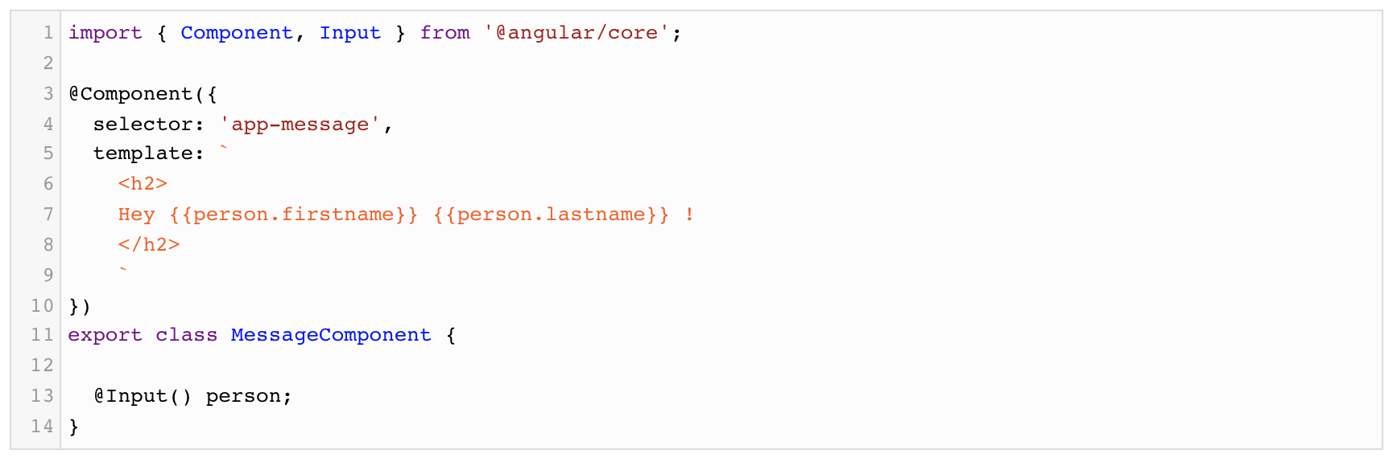
MessageComponent Default strategy

Slide 52
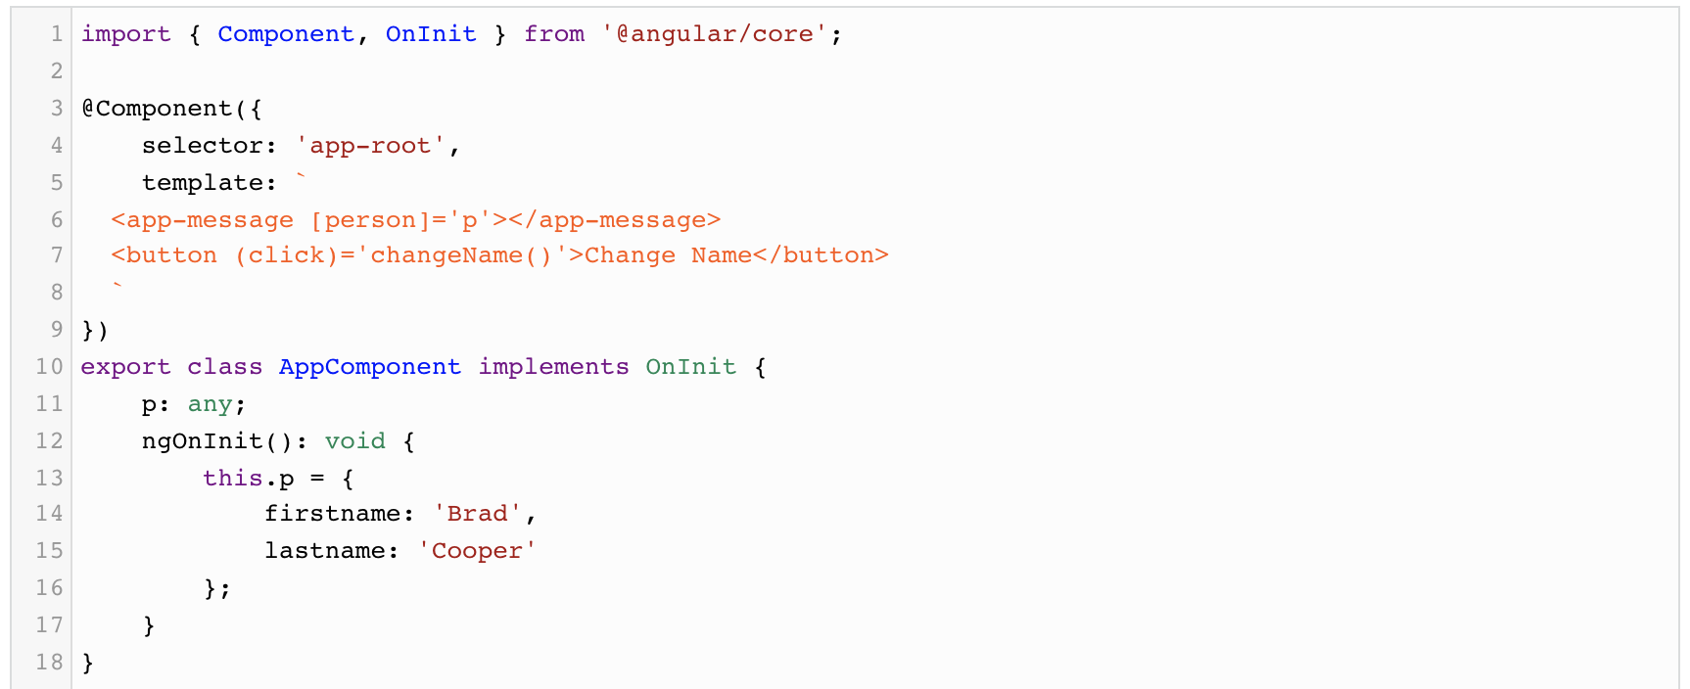
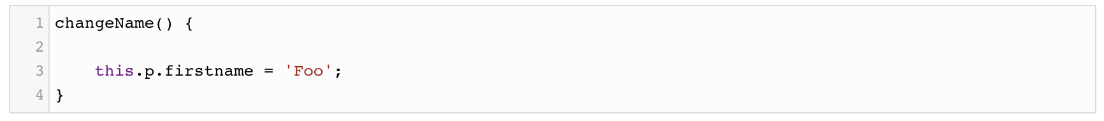
AppComponent Default strategy

Slide 53
Example OnPush Change detection

Slide 54
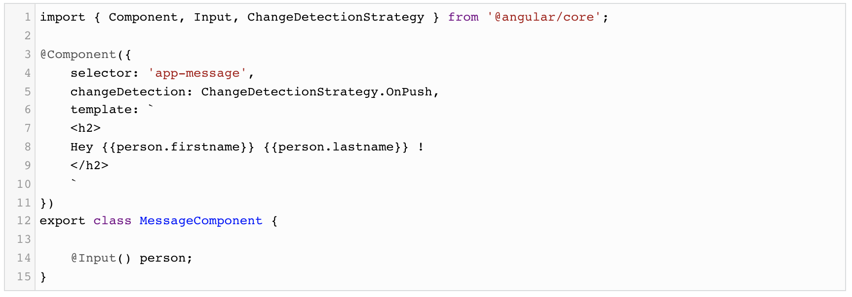
MessageComponent OnPush strategy

Slide 55
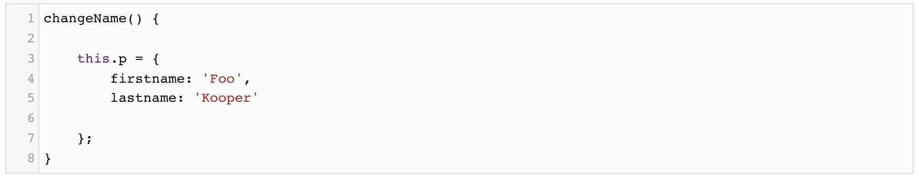
AppComponent OnPush strategy – pass value by reference !!!

Slide 56
Benefits of onPush Change Detection
No Unnecessary change detection of Child Components
Faster Component Re-rendering

Slide 57
Onpush Change detection with Observables
If observable is passed to the onPush change detector strategy enabled component,
then Angular ChangeDetector has to be called manually to update the DOM.
Why manually?
Observables emit new values without changing the reference of the object !

Slide 58
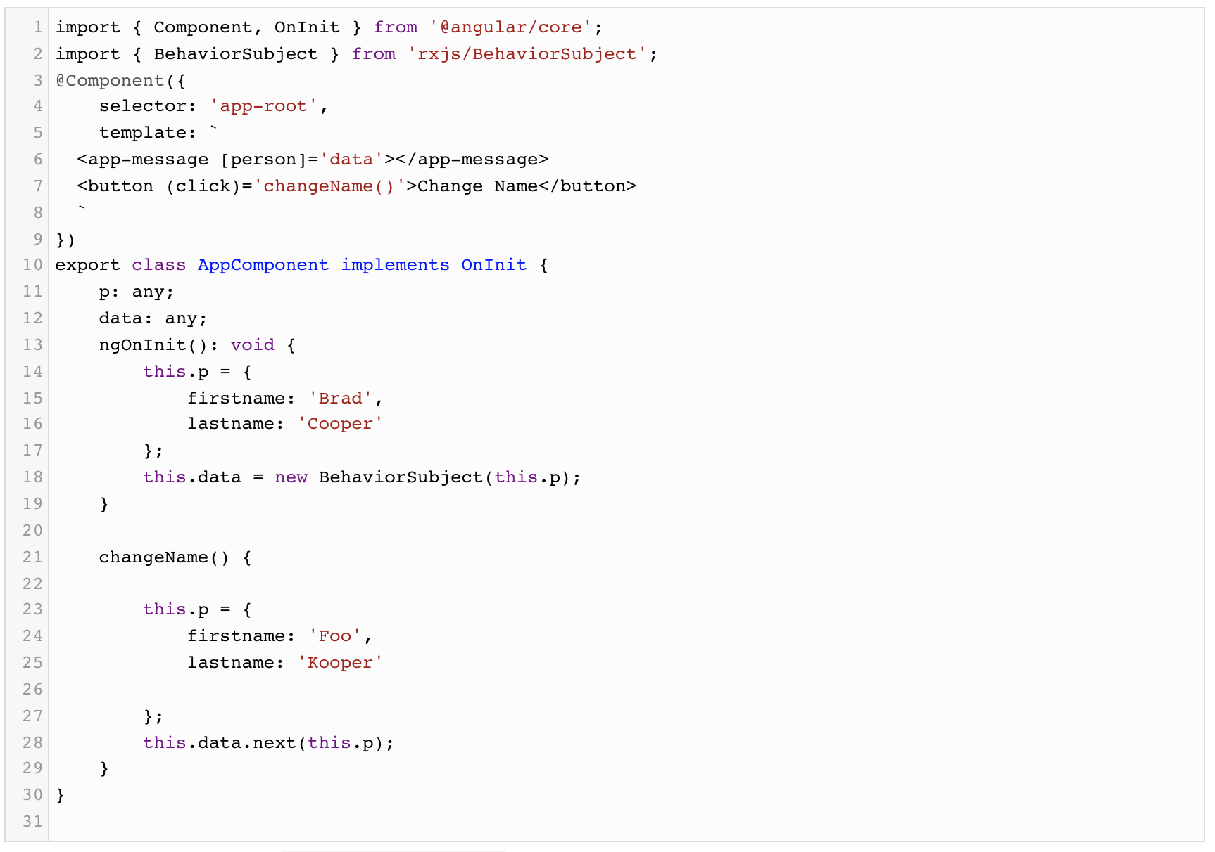

Slide 59
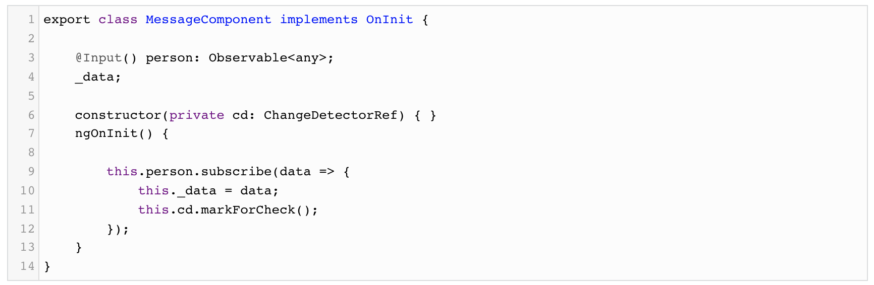

Slide 60
Use pipe Async for change detection Observables!!!

Slide 61
Use pipe Async for change detection Observables!!!
@Component({
selector: 'app-root',
template: `
<app-message [person]='data | async'></app-message>
<button (click)='changeName()'>Change Name</button>
`
})
export class AppComponent implements OnInit {

Slide 62
No subscibe needed!

Slide 63
Onpush Change detection
https://angular-university.io/lesson/angular-rxjs-reactive-patterns-making-deeply-nested-smart-components-work-with-onpush-change-detection
And see article:
https://dzone.com/articles/how-to-use-change-detection-in-angular

